Slide 1
Partnership Concurrency

Slide 2
Goal of this Presentation
To introduce or provide further knowledge around the topic of partnership concurrency
To suggest that:
There are different ways to measure partnership concurrency – with some methods being perhaps less prone to bias/misinterpretation (/more useful) than others
Methods for data collection of partnership concurrency in surveys should be clearly articulated

Slide 3
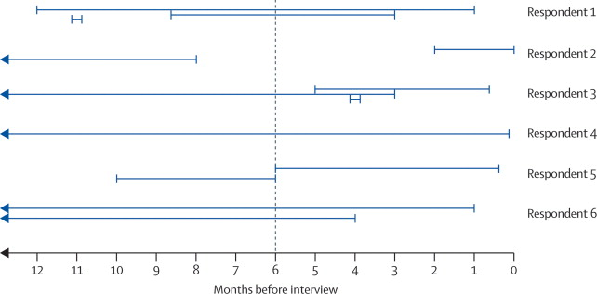
Definitions - Partnership Concurrency
“Having two or more partnerships that overlap in time” -aidsfree.usaid.gov
“Overlapping sexual partnerships in which sexual intercourse with one partner occurs between two acts of intercourse with another partner”
– UNAIDS Reference Group on Estimates, Modelling, and Projections: Working Group on Measuring Concurrent Sexual Partnerships
https://www.thelancet.com/journals/lancet/article/PIIS0140-6736(09)62040-7/fulltext

Slide 4
Definitions – Mean Degree
Mean degree of a sexual partnership network
a measure of partnership network connectivity
represents the average number of partnerships at a point in time which are
active
ongoing

Slide 5
Definitions – RADAR and ART-Net
RADAR Project
Stands for: Research on Adverse Drug Events and Reports
Purpose: To understand the interplay of HIV and substance use
Northwestern University Feinberg School of Medicine
16-29 year old YMSM in Chicago
Number of Participants
Longitudinal
ART-Net Study
Stands for: ART Network(?)
Purpose: Modeling Antiretroviral-Based Prevention among Men Who Have Sex with Men in the United States
Emory University
Subset of AMIS
Number of Individuals
Cross-sectional egocentric network design

Slide 6
Overview
Goal
Estimate partnership mean degree from the RADAR dataset using two methods and compare results from these methods
Problem
Like the ARTnet study, the RADAR survey asks participants to consider their sexual partnerships. But in contrast to ARTnet, participants are not asked to identify whether these partnerships are active and ongoing at the day of survey
Objective
Provide a recommendation for how RADAR partnership data may be used to estimate mean degree
Solution
Use ARTnet to identify the relationship between partnership concurrency and mean degree

Slide 7
Defining an Active and Ongoing Partnership - ARTnet
Partnerships in the past 12 months – censored at max 5
Method 1 – Day of Survey
Uses explicit ARTnet Survey question
On the day of survey, asked: “Do you think you will have sex with [partner] again?”
Method 2 – Month Offset
Derived from reported partnership start and end dates
Start date are dates of first sex with partner
Uncertain on end date, but values right censored to date of survey

Slide 8
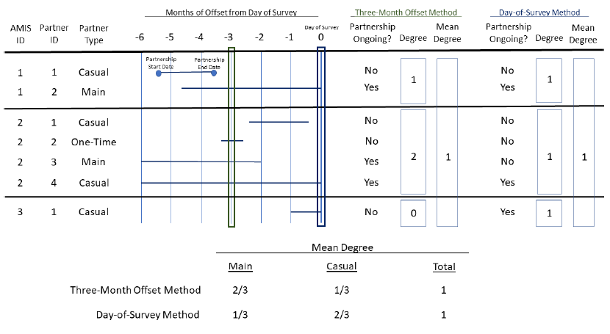

Slide 9
Preliminary Results

Slide 10
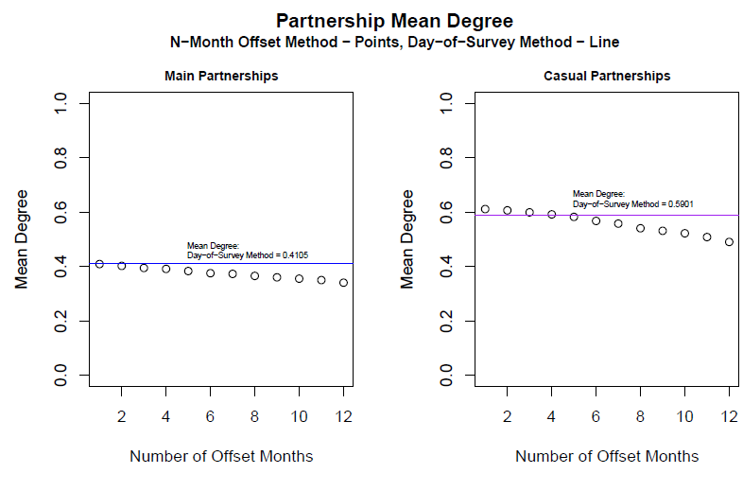

Slide 11
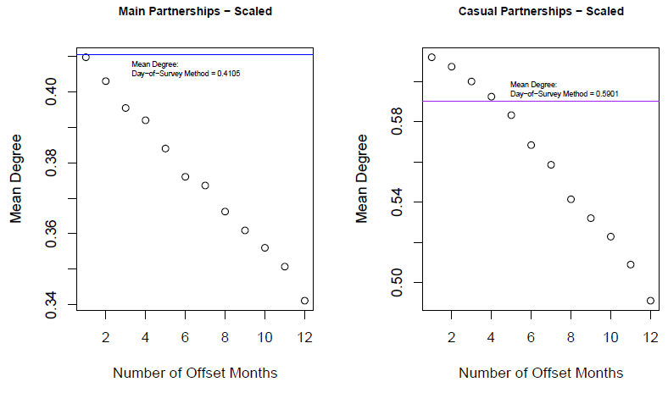

Slide 12
Follow-Up
Why is day of survey mean degree higher than 0 month offset for main partnerships?
Why is day of survey mean degree lower than 0 month offset for casual partnerships?
Why is there decline in mean degree with additional months of offsetting?
Test hypotheses for mechanisms responsible for the above.

Slide 13
ID1
ID1
ID1
ID1

Slide 14
Paper Outline
Introduce partnership concurrency as it pertains to sexual networks
Introduce two methods for determining degree of partnership concurrency, along with strengths and weaknesses of both methods
Apply these two methods to ARTnet – discuss crude analysis results
Investigate mechanisms for discrepancies and discuss findings of which mechanisms, in the ARTnet comparison, were suggested to be driving the difference in results
Implications - Sensitivity analysis for how incidence/prevalence differs depending on which method is used?
Conclusions about importance of consideration for methods used to derive partnership concurrency parameters, possible strengths and limitations with using each method, and mechanisms for which bias may impact parameter estimation

